Slide 1

Secure Programming Guidelines for the C programming language
By Nader Khaled

Slide 2

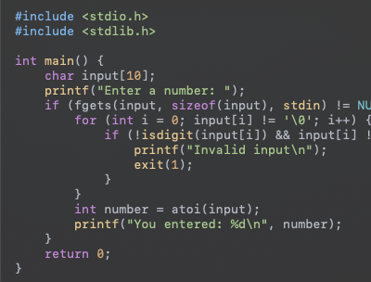
Input Validation
Input validation prevents invalid or malicious data from being processed, reducing vulnerabilities like buffer overflows or injection attacks.

Slide 3
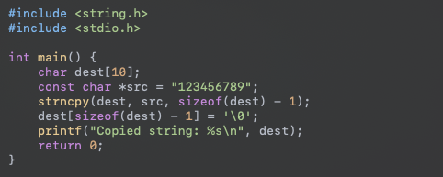
Use safe function
Using functions like strncpy instead of strcpy helps avoid buffer overflows by specifying the maximum number of characters to copy.

Slide 4
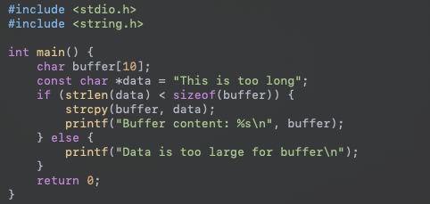
Avoid Buffer Overflows
Avoiding buffer overflows protects against potential memory corruption and arbitrary code execution.

Slide 5
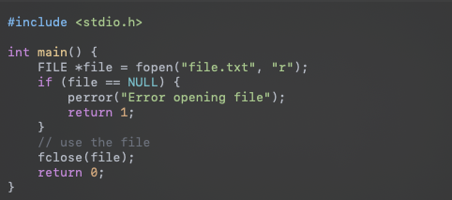
Check Return Values
Checking return values ensures proper error handling and resource management.

Slide 6
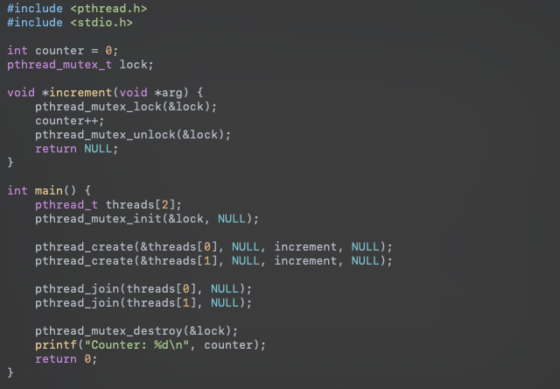
Avoid Race Conditions
Proper synchronization prevents race conditions, ensuring consistent and predictable behavior in multi-threaded programs.

Slide 7
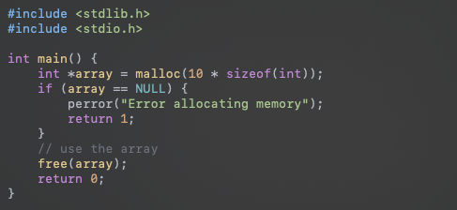
Free Allocated Memory
Freeing allocated memory prevents memory leaks, ensuring efficient use of resources and preventing exhaustion.

Slide 8
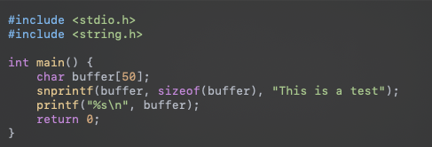
Avoid Using Deprecated Functions
Using updated and supported functions ensures that the code benefits from the latest security fixes and improvements.

Slide 9
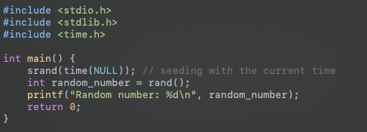
Use Secure Random Number Generation
Secure random number generation is crucial for applications that require high levels of unpredictability, such as cryptographic applications.

Slide 10


